Slide 1

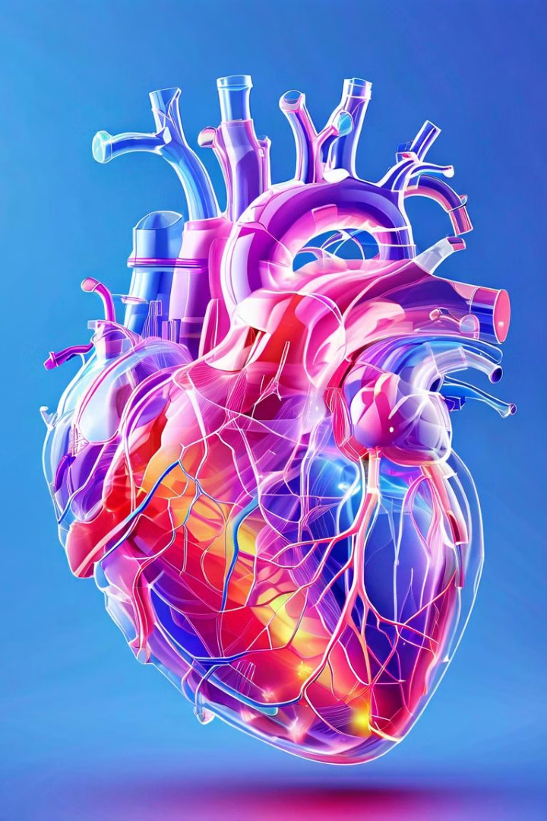
Cardiovascular Diseases
Prediction
Group C

Slide 2
Agenda
Project Timeline
Project Roadmap
Coding Standards
Challenges Faced
How did we Overcome
Analysis and Insights
Dashboard

Slide 3
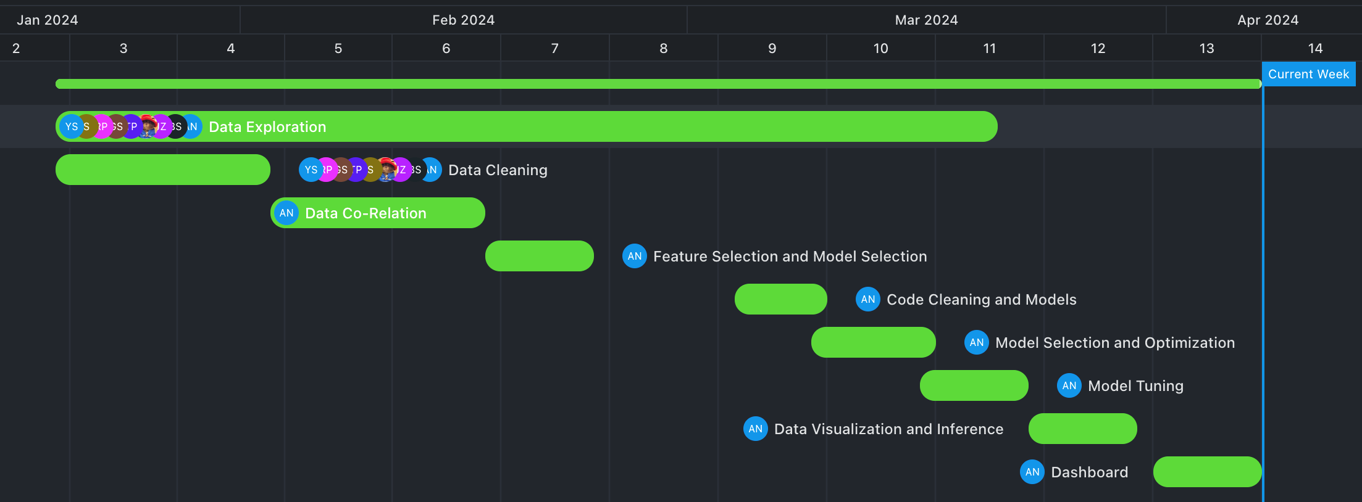
Project Timeline

Slide 4

Project Roadmap
Data Preprocessing
1
Data collection and Cleaning.
Data Consistency and Splitting.
2
Data Exploration
Univariate analysis for distribution and outliers.
Bivariate analysis to uncover relationships.
Feature Engineering
3
One-Hot Encoding
Data Scaling
Feature Extraction
4
Models and Metrics
Logistic Regression, Random Forest and Boosting Classifiers
Metrics: Accuracy, Precision, Recall, F1 Score, ROC-AUC.

Slide 5
Project Roadmap
Model Tuning and Dumping
5
Random Search CV
LIME
Joblib for dumping
6
Analysis and Insights
Model Performance Metrics
Feature Important Analysis
Dashboard/UI

Slide 6




Coding Standards
Virtual Environment
PEP 8 Standard
Modularization
Keep project dependency separate
Makes sure the project runs the same on different machine
Guideline for coding styling and formatting
Enhance code readability and formatting
Breaks code into reusable component
Class and Function based
Clear to understand and collaborate
Notes:
PEP stands for Python Enhancement Proposal 8

Slide 7
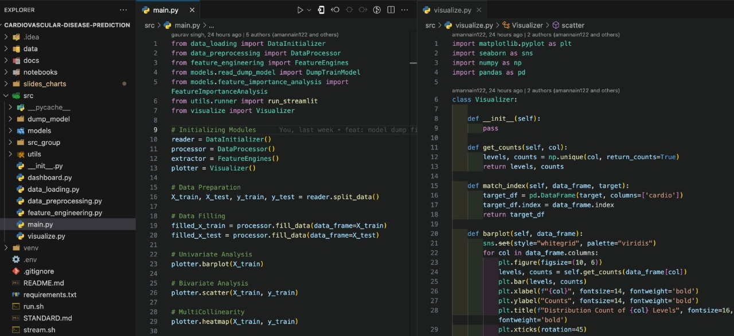

Slide 8

Challenges Faced
1
Data Collection
Large Amount of Data
Legit Data Sources
2
Model Selection
Computation Speed
Strong Metrics
3
Model Tuning
Make Generalized Model
Higher Score on Required Metric

Slide 9

How did we Overcome
1
Data Collection
Implemented data samplin
Legit Data Sources
2
Model Selection
Computation Speed
Strong Metrics
3
Model Tuning
Make Generalized Model
Higher Score on Required Metric

Slide 10

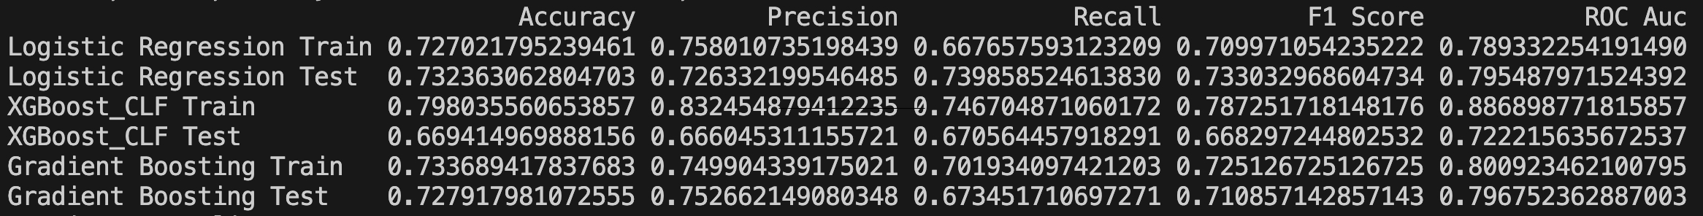
Model Selection and Metrics
Boosting Classifier: XGBoost
Allows for more sophisticated feature engineering with different data types
High Level of Interpretability through feature importance rankings.

Slide 11

4. Model Tuning
Model tuning, also known as hyperparameter tuning, refers to the process of adjusting the settings or parameters of a machine learning model to optimize its performance. This optimization aims to improve the model's accuracy, robustness, and ability to generalize well to new data. Hyperparameters are configuration settings that are not learned from the data but are set before the training process begins, such as learning rates, regularization strengths, tree depths in decision trees, and the number of iterations in boosting algorithms. By tuning these hyperparameters, we can fine-tune the behavior of the model to achieve better results on unseen data.

Slide 12
Analysis and Insights (Model Explainers)​
1
ROC Curve
Graph showing true positive rate against false positive rate.
2
Confusion Matrix
Matrix showing the counts of true positives, false positives, true negative, and false negative predictions made by a classification model.

Slide 13
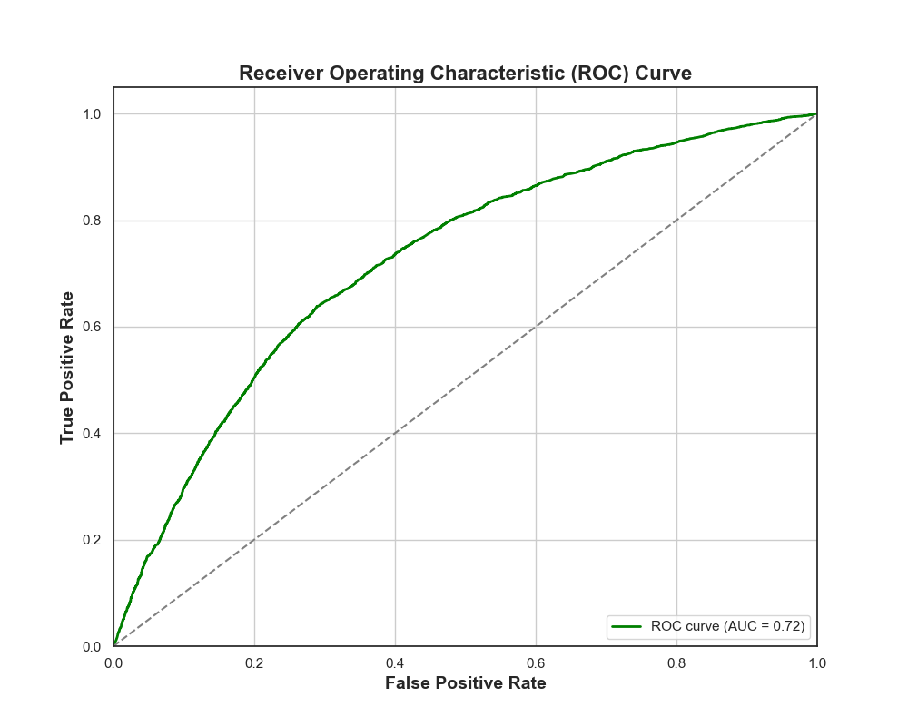
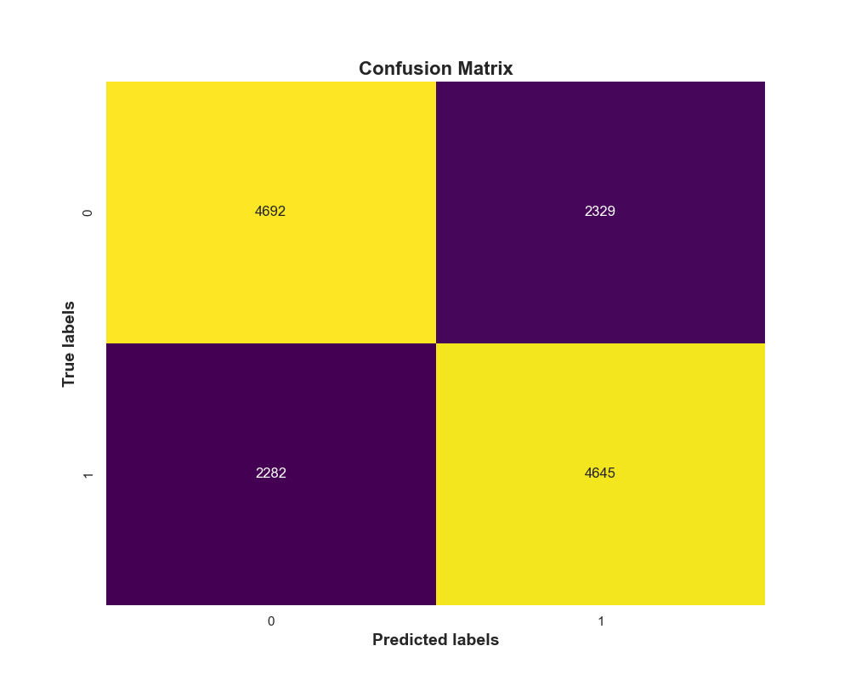
​ROC Curve
Confusion Matrix

Slide 14
Analysis and Insights (Model Explainers)​
1
ROC Curve
2
Confusion Matrix
Graph showing true positive rate against false positive rate.
Matrix showing the counts of true positive, false positive, true negative, and false negative predictions made by a classification model.
3
Feature Importance
4
Permutation Analysis​
Ranking or score indicating the relative importance of features in influencing model predictions.
Technique evaluating feature importance by randomly shuffling feature values to measure their impact on model performance.

Slide 15
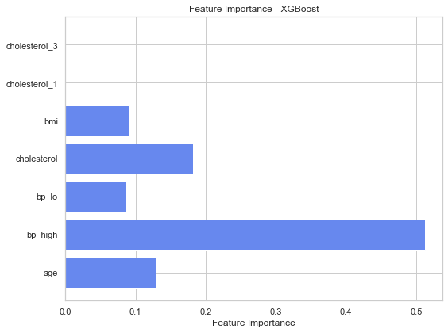
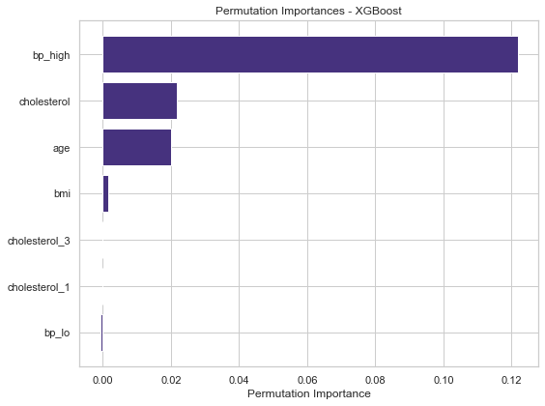
​Feature Important Analysis
Permutation Analysis

Slide 16

Dashboard
Streamlit (Python Library)
Python Powered interactivity to make web app
Easy to deploy ML models
https://openmind.streamlit.app

Slide 17
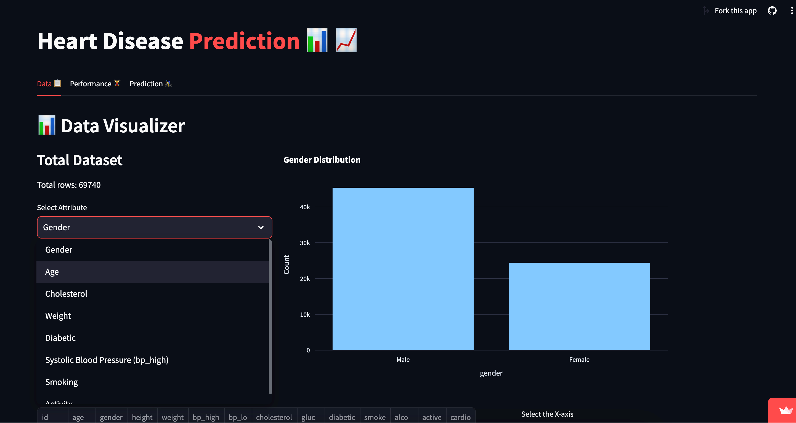
Data Visualization​

Slide 18
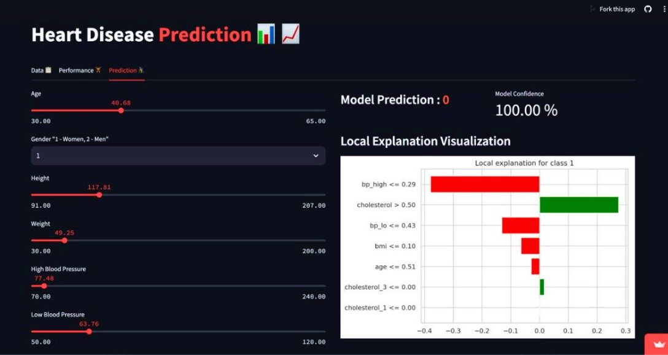
Data Visualization​

Slide 19
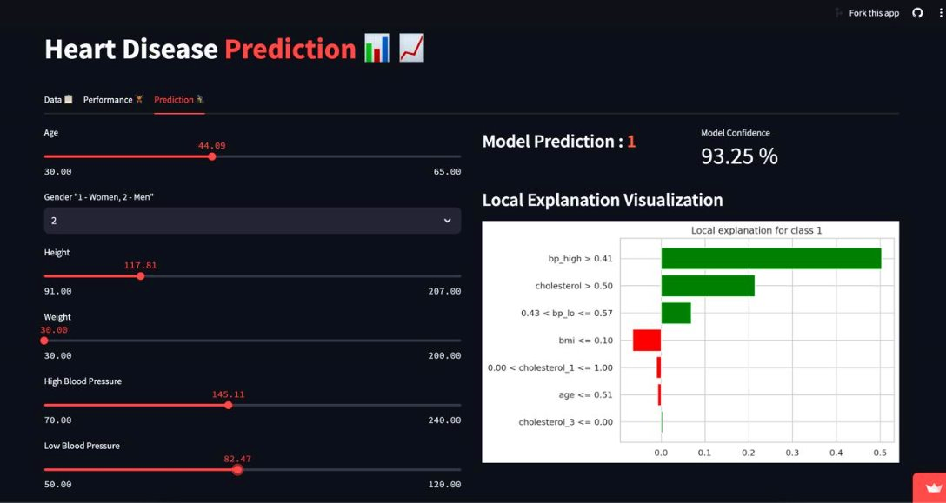
Data Visualization​

Slide 20
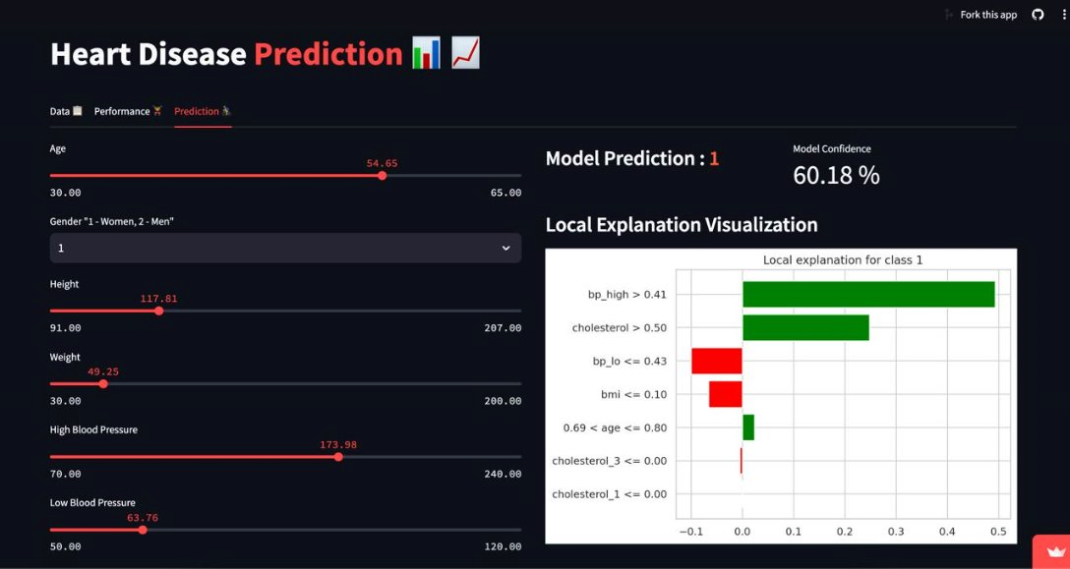
Data Visualization​

Slide 21
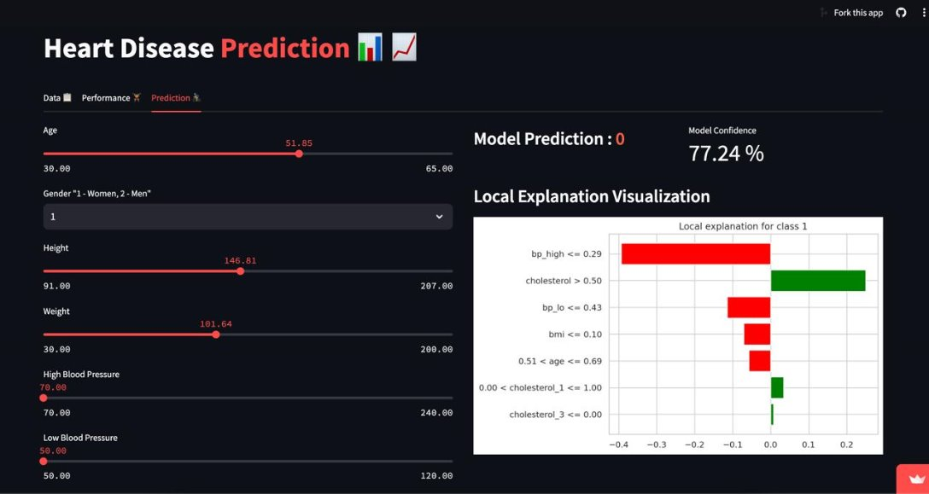
Data Visualization​

Slide 22
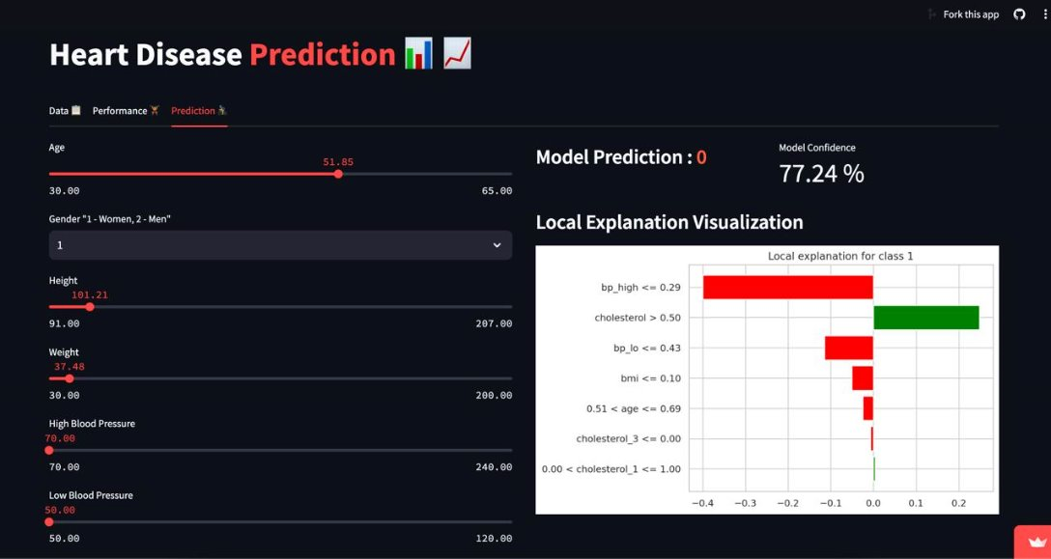
Data Visualization​

Slide 23

Conclusion and Future Directions
In conclusion, the development of a robust cardiovascular disease prediction model using machine learning techniques holds immense promise. The insights gained from this project can pave the way for more accurate and personalized risk assessment, enabling earlier interventions and improved patient outcomes.
Looking ahead, future research directions may include incorporating advanced deep learning architectures, leveraging larger and more diverse datasets, and exploring the integration of additional data sources such as genomic and wearable device information.

Slide 24

Open for Collaboration🤩
https://github.com/OpenMinds-LCIT/cardiovascular-disease-prediction
https://openmind.streamlit.app/

Slide 25


